Slide 1
Tablet
Documentation
Diogo, Lio, Ray, Jose, Sam and Cameron

Slide 2
Quick Links
GITHUB
BOM
CAD
USER GUIDE

Slide 3
Documentation Map
Review of High-Level Goals
Design Overview
CAD
Key Supporting Analysis
Demonstrations
Notes:
Cam

Slide 4
Challenge Overview
Move 2 points around in a plane
Provide force to user through magnet
User can interact with various virtual objects through display
Robot can track location of 1 or 2 fingers
Notes:
Cam

Slide 5
Technical Requirements
Continuous 6N at the end effector
Moving speed up to 150 mm/s
Wall stiffness of 1N/mm
Documentation: Requirements & Architecture
Notes:
Cam

Slide 6
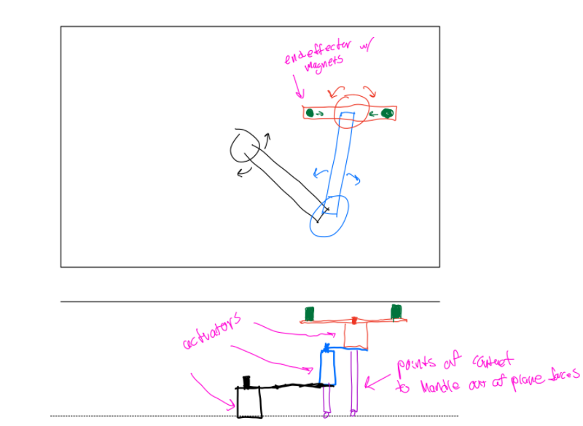
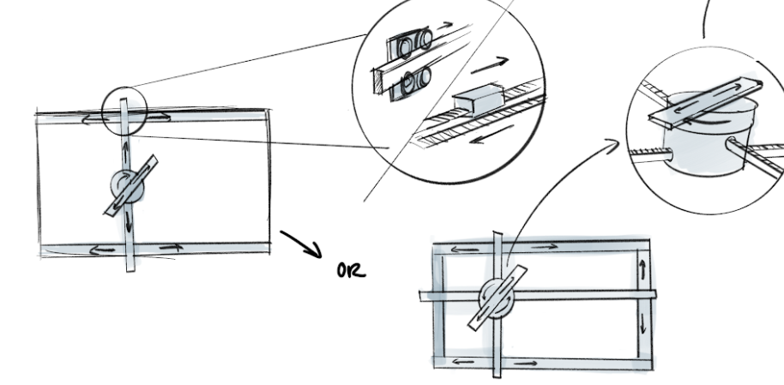
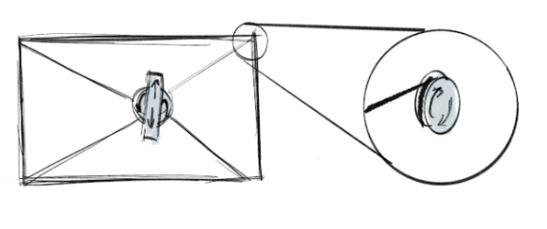
Concept Phase
Brainstorm different ways to achieve all DOF:
Gantry systems
Cable systems
Linkage systems
Documentation: Requirements & Architecture
Notes:
Diogo

Slide 7
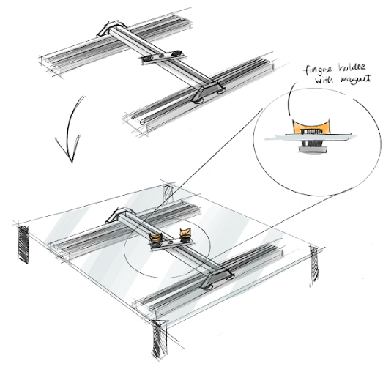
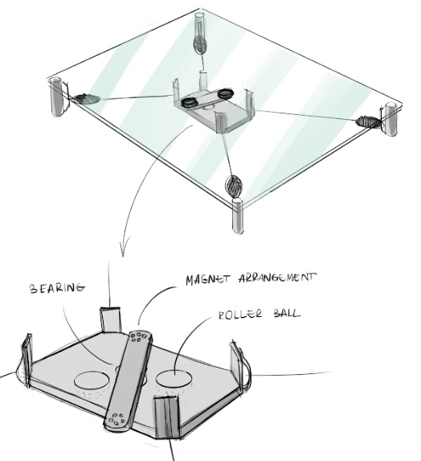
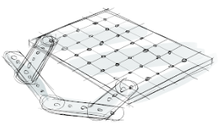
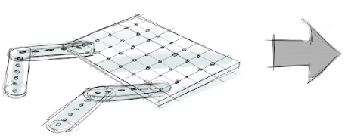
Concept Phase
Ideation of prototypes:
Gantry
Cable Bot
Open Linkage
Closed Linkage
Documentation: Refine Concepts
Notes:
Diogo
Things we wanted to test:
Positional accuracy
Friction
Singularity
Envelope

Slide 8
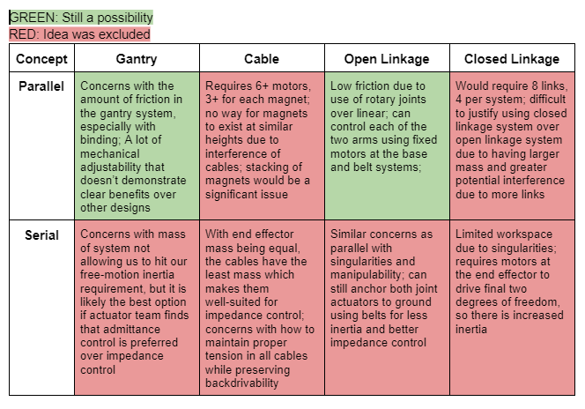
Mechanism
Narrowed the ideation to two concepts:
Parallel Gantry
Paralel Open Linkage
Documentation: Prototype Subsystems
Notes:
Cam

Slide 9
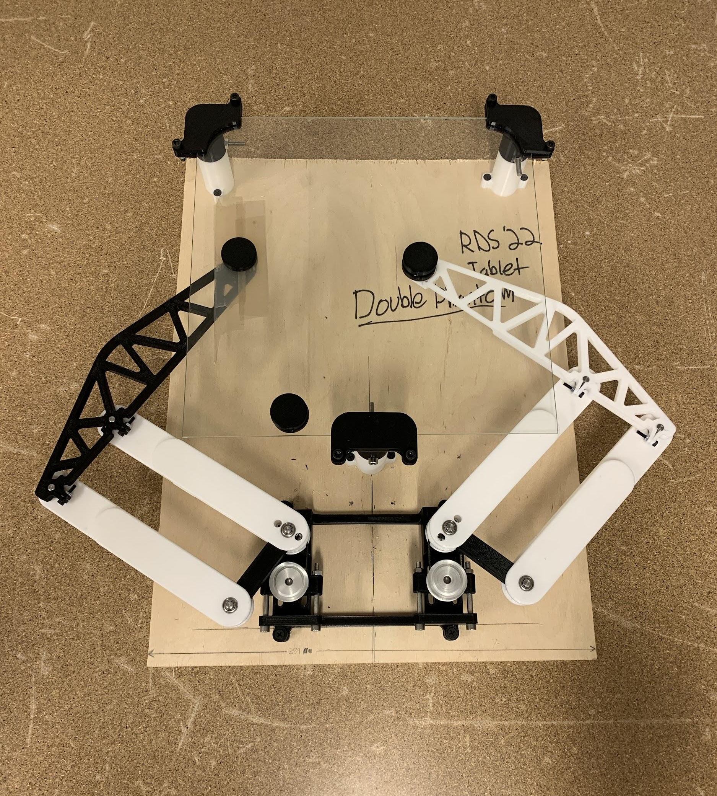
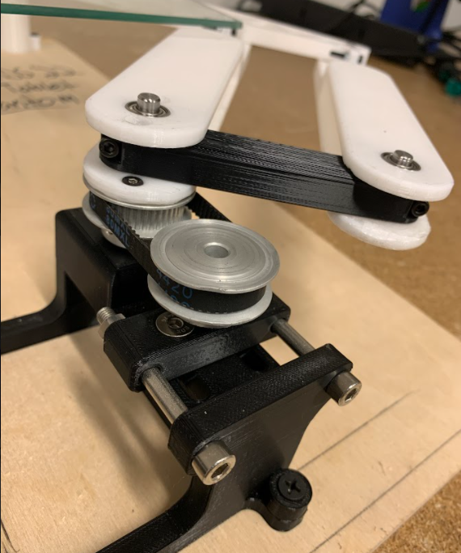
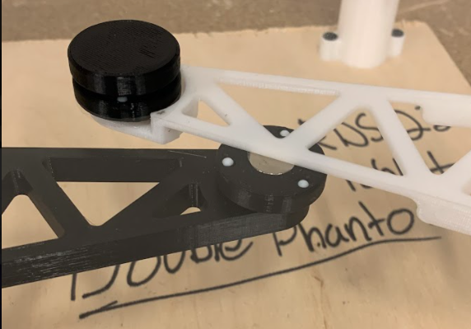
Mechanism
Notes:
Cam

Slide 10
Mechanism
Ultimately decided on two, 2R arms with parallel linkages
Easier to control friction at shafts w/ bearings than with rolling surfaces
Low inertia - motors mounted at base rather than on frame
Parallel design much more straightforward than in gantry system
Documentation: Integrate Subsystems
Notes:
Cam

Slide 11
Documentation Map
Review of High-Level Goals
Design Overview
CAD
Key Supporting Analysis
Demonstrations
Notes:
Cam

Slide 12
Design Overview: Mechanical

Slide 13
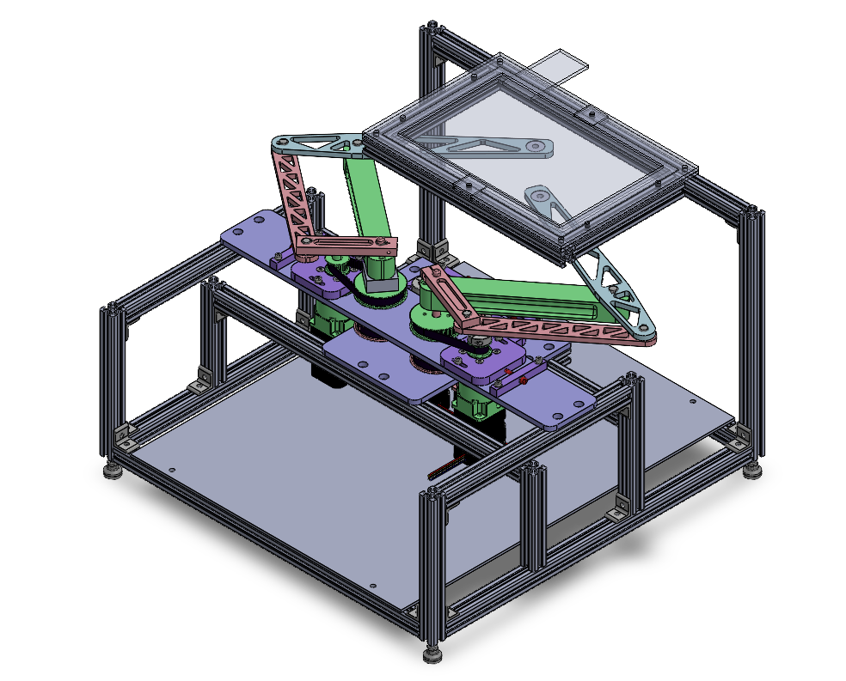
Design: Top Level
Touchscreen tablet
Symmetric phantom 2R linkages
Key Requirements
Continuous 6N at each end effector
Track fingers moving 150 mm/s
100 micron resolution of position at each end effector
User experiences 100 grams or less of inertia in free motion
20 mm profile 80/20 frame
Acrylic base plate
Transmission
Notes:
Sam

Slide 14
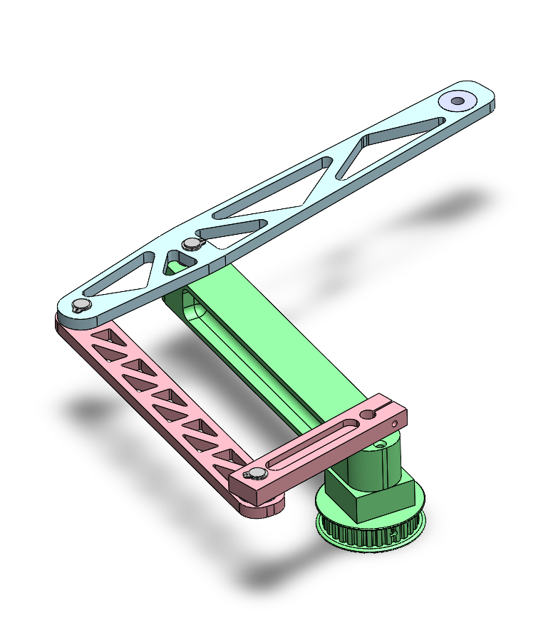
Design: Phantom Linkage
Pros
Commonly solved kinematics
Low inertia; all motors anchored to mechanical ground
Uses only revolute joints; minimal friction and chance of binding
Cons
Performs differently across workspace
Extends beyond workspace; doesn’t package cleanly
Added inertia from proximal and outer links
Distal link
Base link, provides out-of-plane stiffness
Proximal link
Outer link
All links made from AL6061
Notes:
Sam

Slide 15
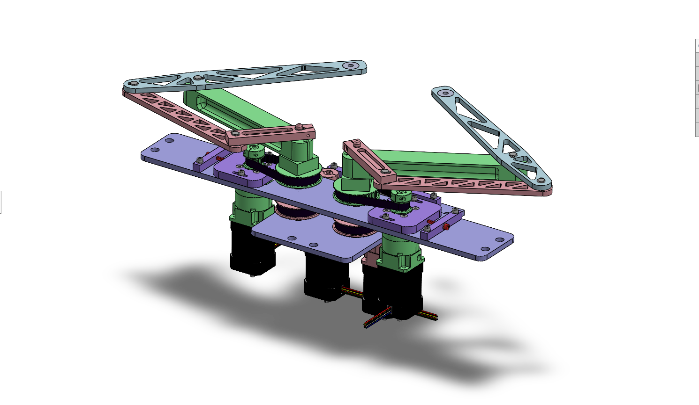
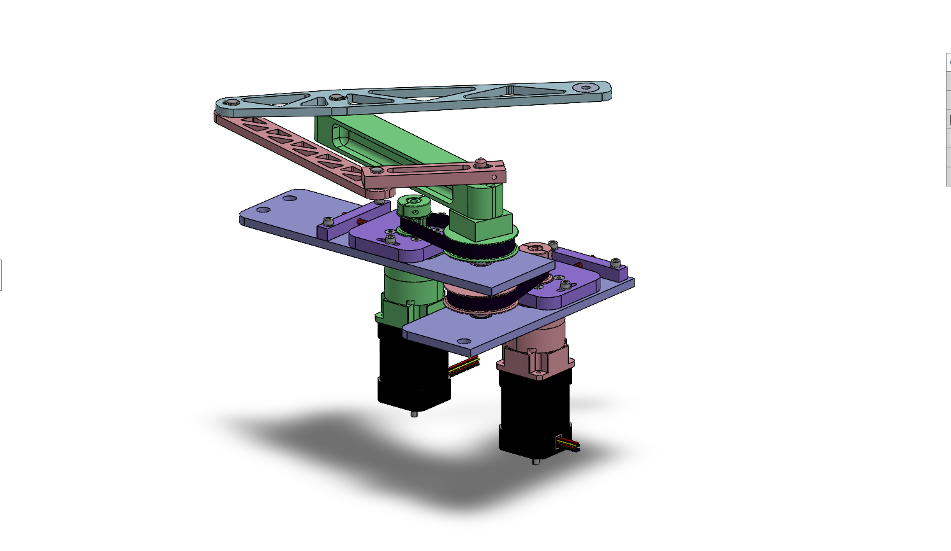
Design: Transmission
Common shaft / axis
2.5:1 XL timing belt reduction
2X 5:1 planetary gearbox
2X brushless DC motor
Notes:
Sam

Slide 16
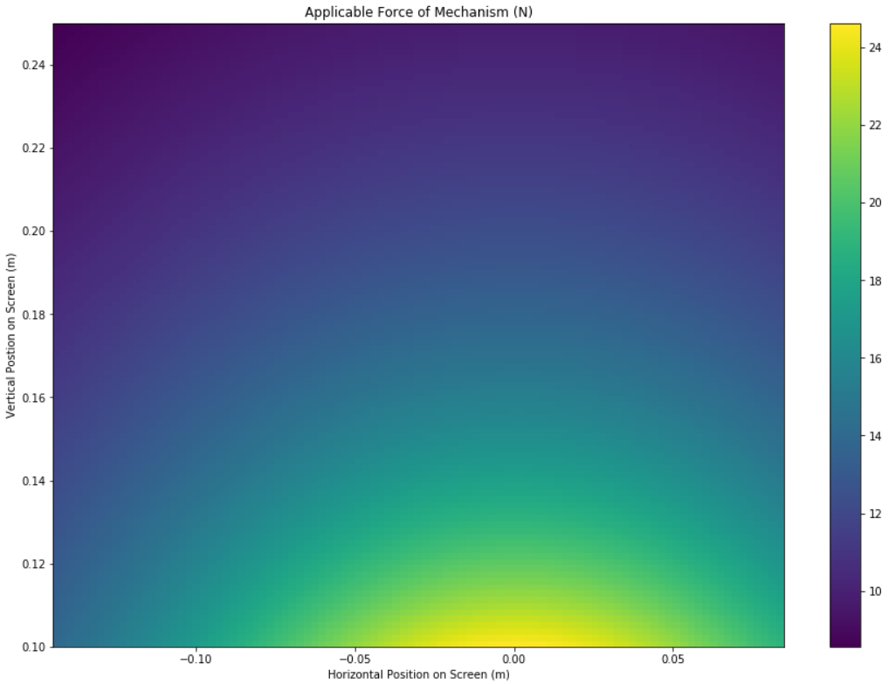
Transmission Component Selection
Rationale
6N required continuously at end effectors
High torque motor with 12.5:1 overall transmission reduction meets force requirement
Gearbox has 0.1 degrees of backlash, which is too much when projected to end-effectors
Include pulley reduction between gearbox and output shafts to reduce backlash at the end effectors
Results
Min. feasible output force: 8.5 N
Max. projected backlash: 0.31 mm
Max. reflected inertia: 32 g
Minimum Feasible Output Force Across Workspace (N)
*Detailed motor specs, gearbox specs, and other workspace color plots in reference slides
*For right-hand linkage
Notes:
Sam

Slide 17
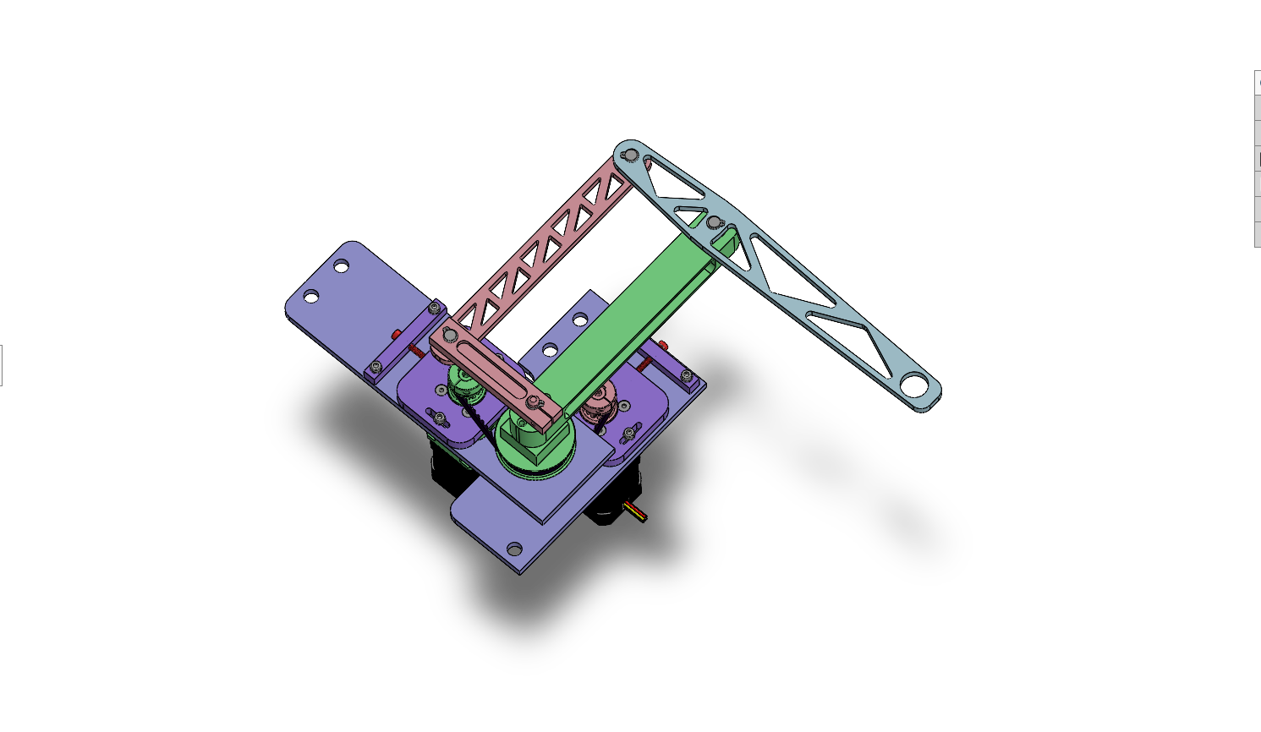
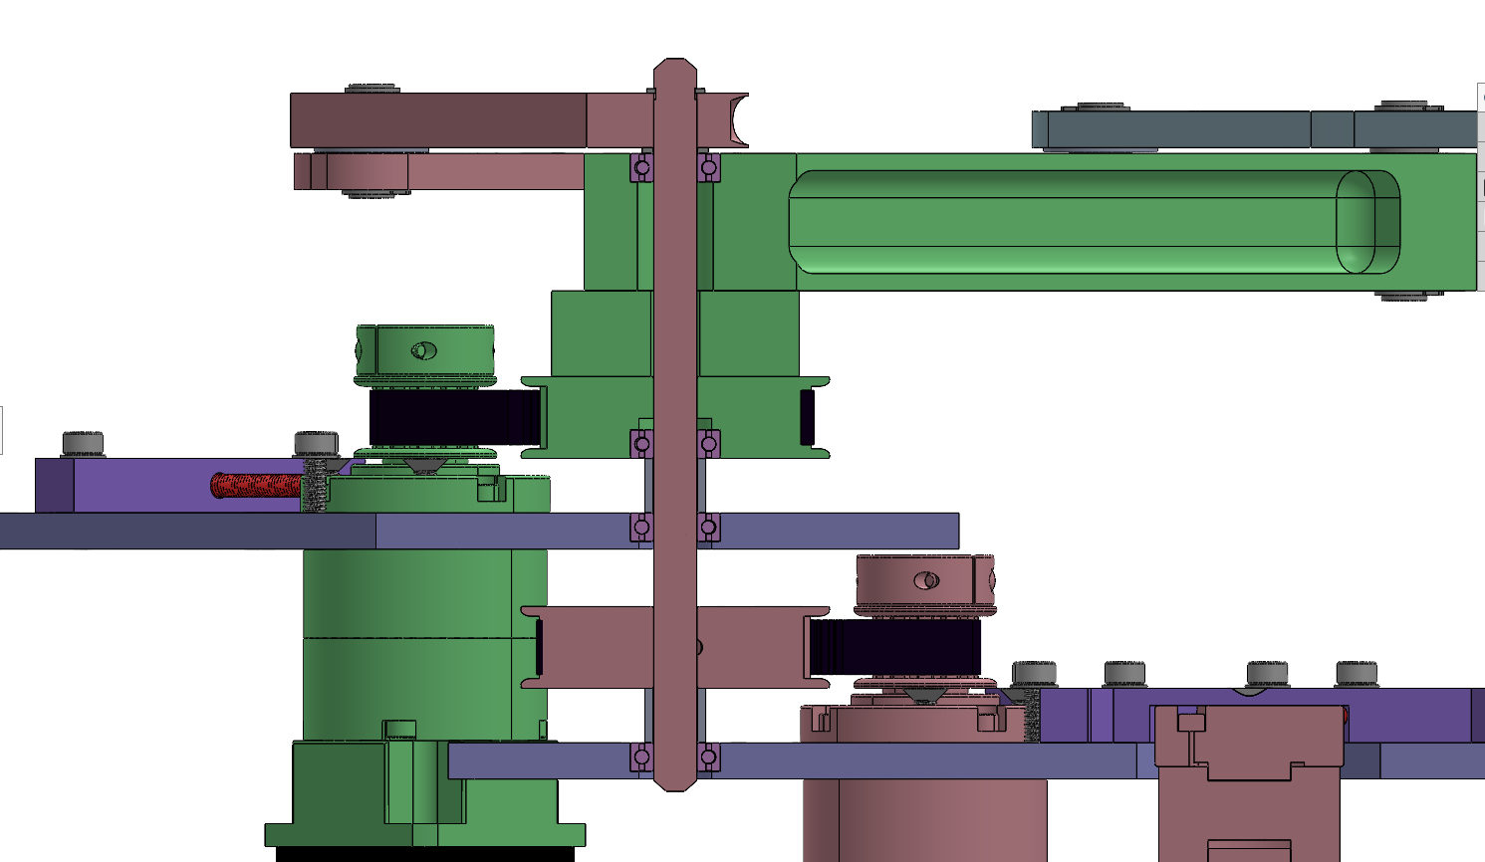
Shaft Stack: Common Axis
Proximal link- clamps to keyed shaft
4X radial ball bearing- friction fit in parent material
Active spacer- fastened to pulley and base link
8mm keyed steel shaft
2X Passive spacer- sits on inner race of bearing
2X AL6061 mounting plate
Timing belt pulley- keyed to shaft with friction fit
*Some components hidden for clarity
Notes:
Sam

Slide 18
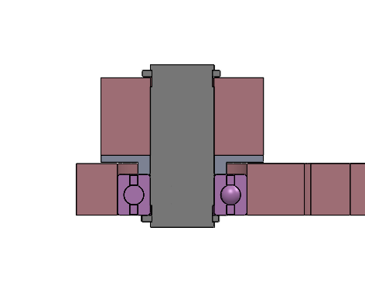
Shaft Stack: Proximal-Outer Axis
2X c-clip- provides axial retention
Proximal link
8mm steel shaft- tight slip fit with bearing and proximal link
AL6061 spacer- rests on bearing inner race
Radial ball bearing- friction fit with outer link
Outer link
Notes:
Sam

Slide 19
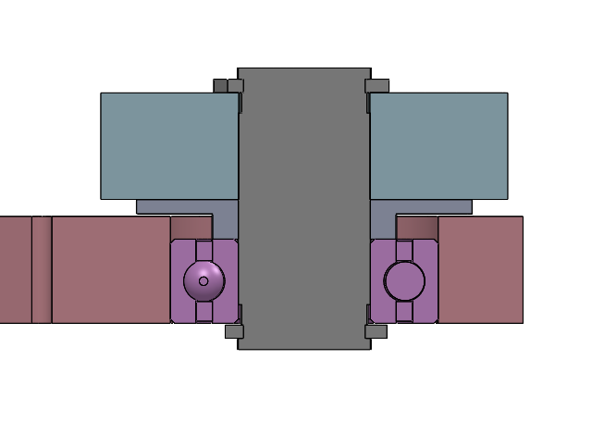
Shaft Stack: Distal-Outer Axis
2X c-clip- provides axial retention
Distal link
8mm steel shaft- tight slip fit with bearing and distal link
AL6061 spacer- rests on bearing inner race
Outer link
Radial ball bearing- friction fit with outer link
Notes:
Sam

Slide 20
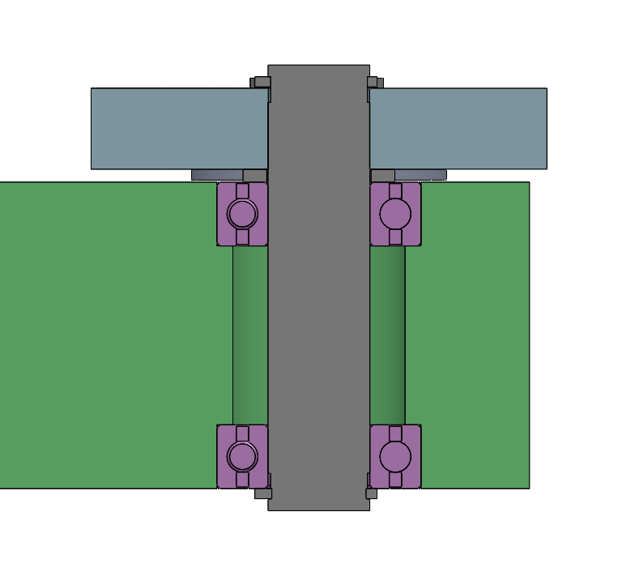
Shaft Stack: Base-Distal Axis
2X c-clip- provides axial retention
Distal link
AL6061 spacer- rests on bearing inner race
8mm steel shaft- tight slip fit with bearing and distal link
Base link
2X radial ball bearing- friction fit with base link
Notes:
Sam

Slide 21
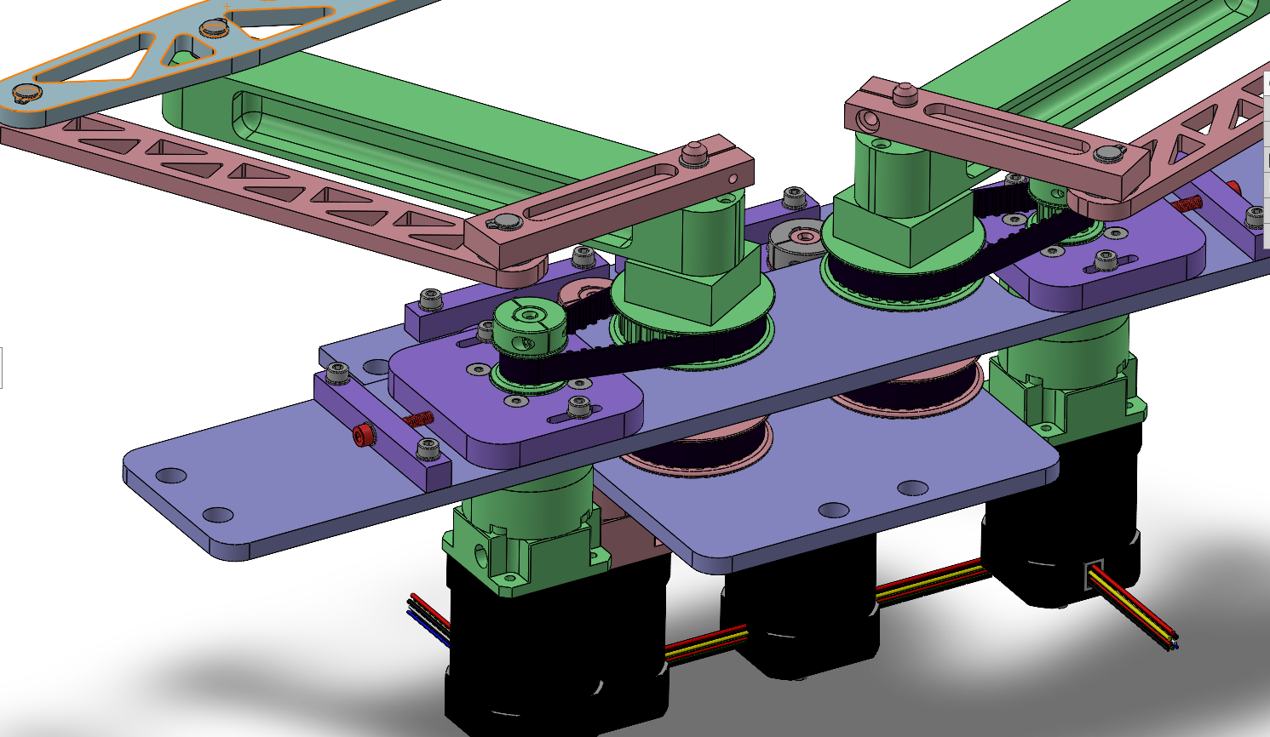
Design: Belt Tensioning
AL6061 tension bar- fixed to plate
Tighten red screw to apply tension to belt
AL6061 gearbox mount- slotted to allow for tensioning
Notes:
Sam

Slide 22
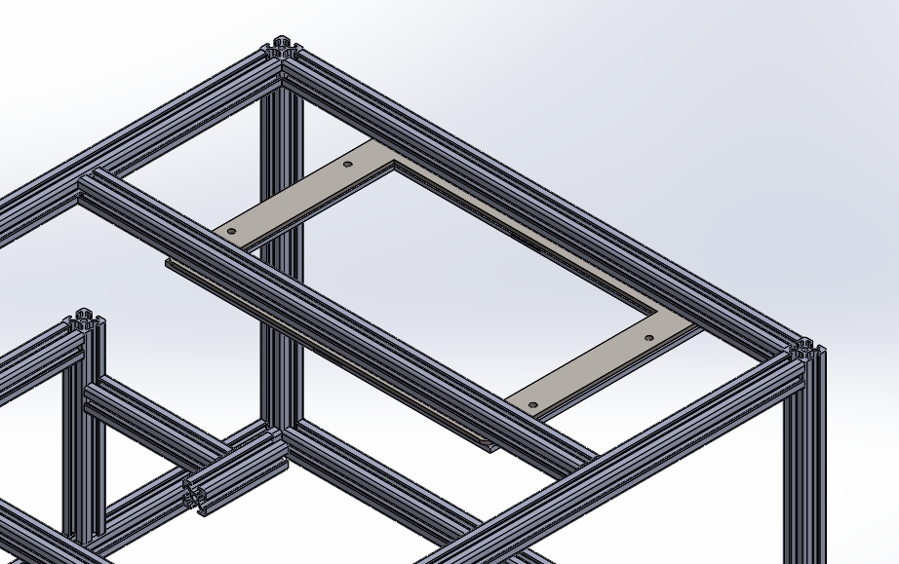
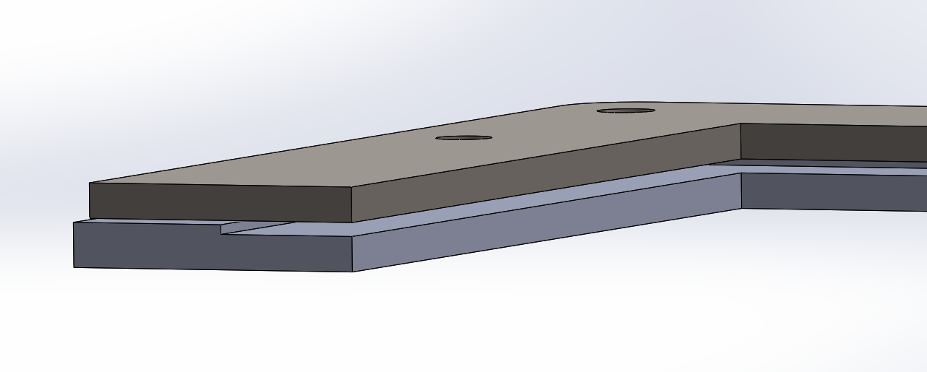
Tablet Mounting
M5 thru bolts to sandwich it together
Aluminum mounting plate
3D printed mount to push tablet to plate
Tablet sits in between the gap

Slide 23
Design: Overview
Key Performance Specs
Min. feasible output force: 8.5 N
Max. projected backlash: 0.31 mm
Max. reflected inertia: 32 g
Mass of one phantom linkage: 0.6 kg
Notes:
Sam

Slide 24
Design Overview: Magnets

Slide 25
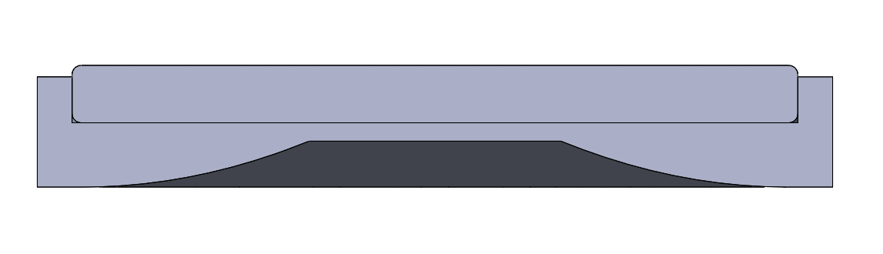
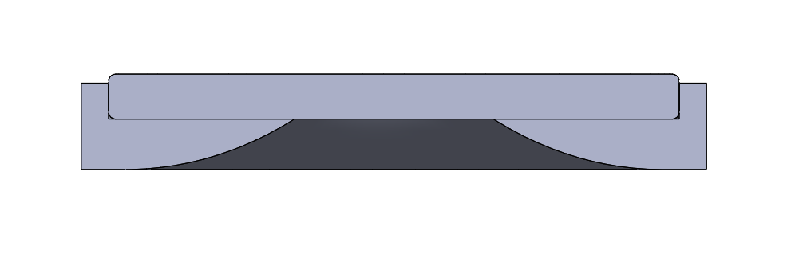
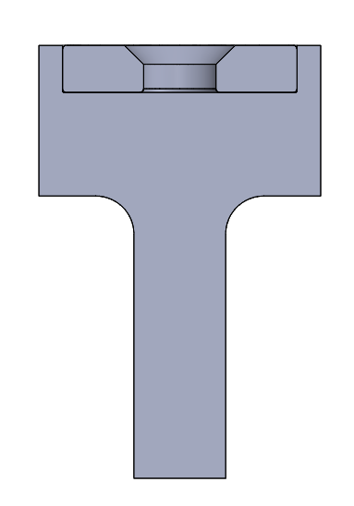
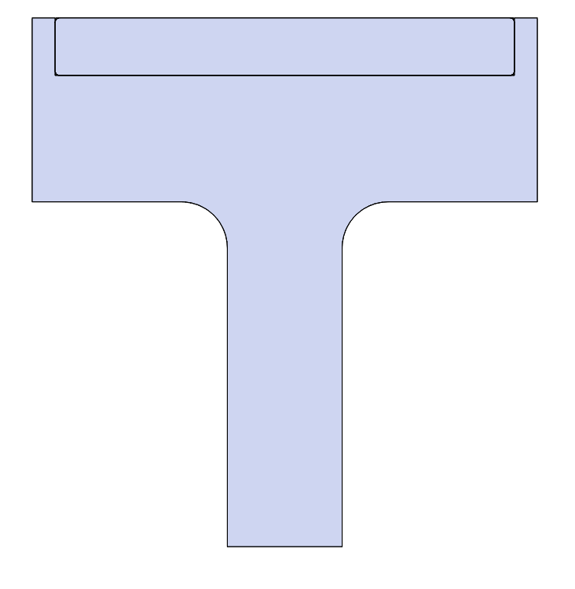
Design Requirements
LOW FRICTION:
In free motion, the user should experience no more than 0.22 lbs or 100 g of inertia.
Match finger speeds up to 150mm/s or 5.9 in/s
HIGH SHEAR STRENGTH:
When the user is interacting with a virtual wall, the device will be able to respond with a stiffness of 1 N/mm or 5.71 lbs/in
Notes:
Diogo

Slide 26
Design Challenges
KEY ISSUE: Friction and shear strength coupled
Many attempts to mitigate friction:
Air bearing
Teflon
Lubricant
Polymagnets
Height variants
Thrust bearings
Notes:
Diogo

Slide 27
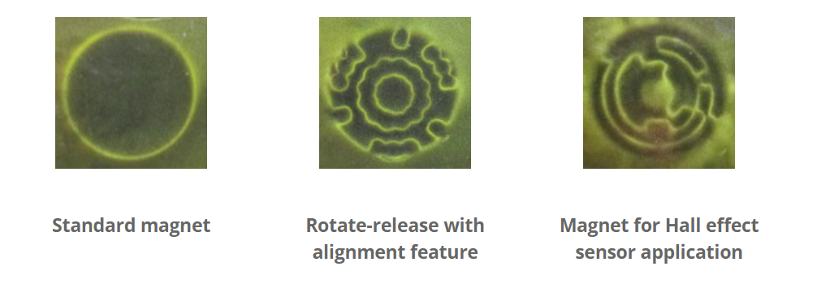
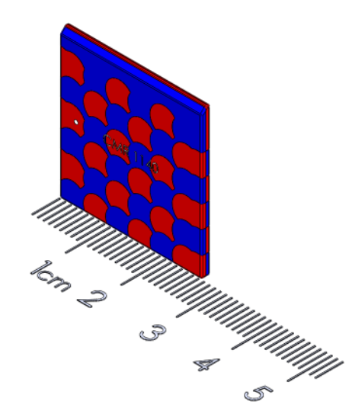
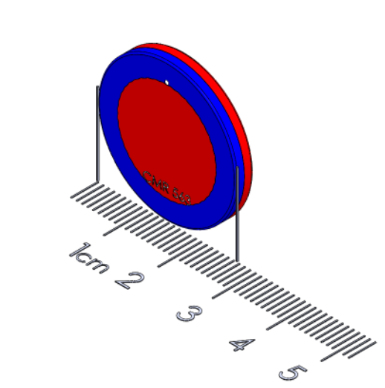
Polymagnets
Company that makes custom magnets to fit specific functions
Custom N/S patterns
Reached out for a consultation
Ordered a 20+ magnets

Slide 28
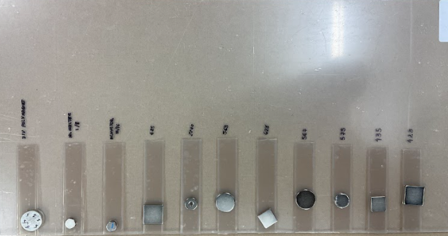
Polymagnets: Testing
Tried different magnet combinations with different friction mitigation techniques
Grease
Teflon tape
Teflon balls
Qualitatively measured shear strength and friction
Results changed once the actual screen was introduced - much larger distance + different materials

Slide 29
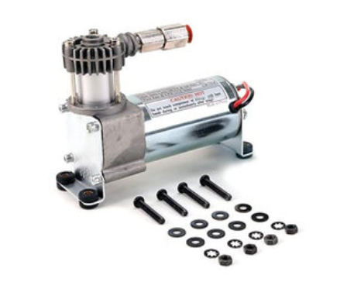
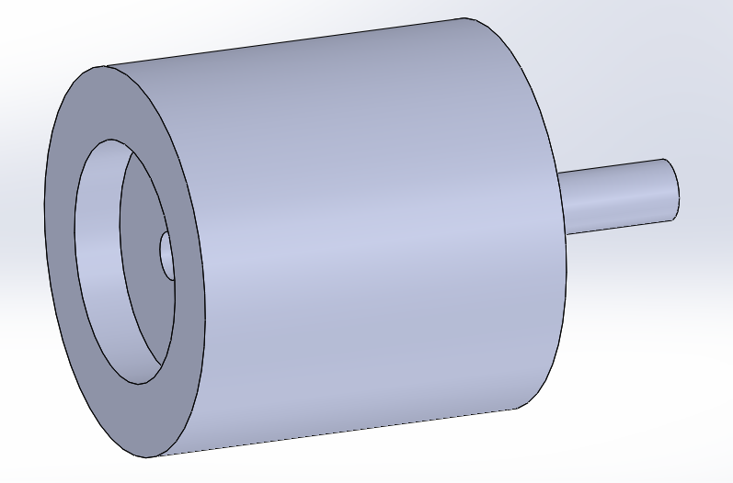
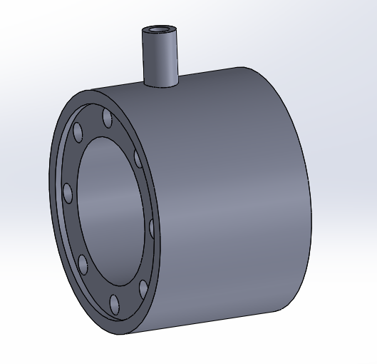
Air Bearings
Ideal solution: Frictionless air bearings
Prototyped several versions of ‘air pucks’ with different magnets
Various compliant materials to seal air bearing to the tablet
Issues:
Unable to develop an effective method of sealing/equally distributing the air
Would need to include the infrastructure/package a pump
Ultimately scrapped the idea
Notes:
Jose

Slide 30
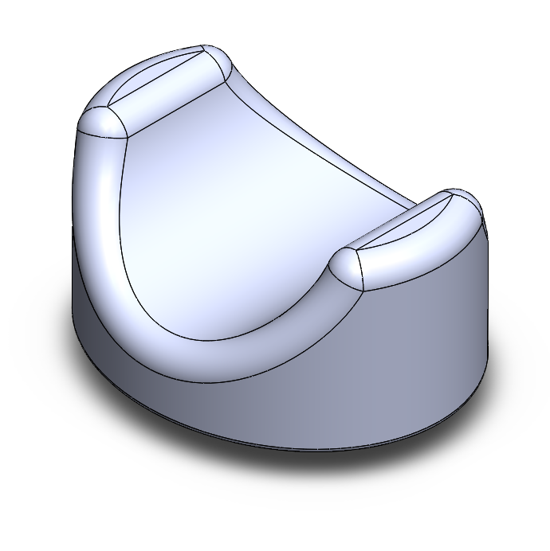
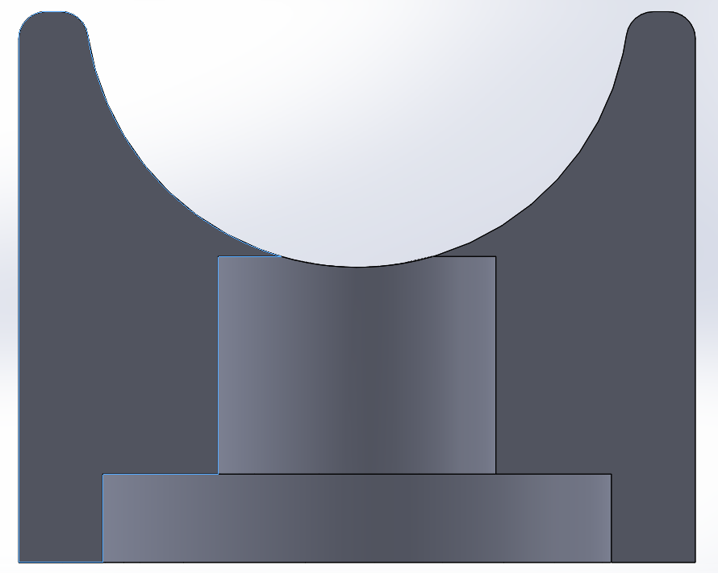
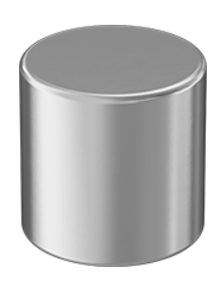
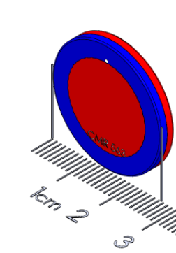
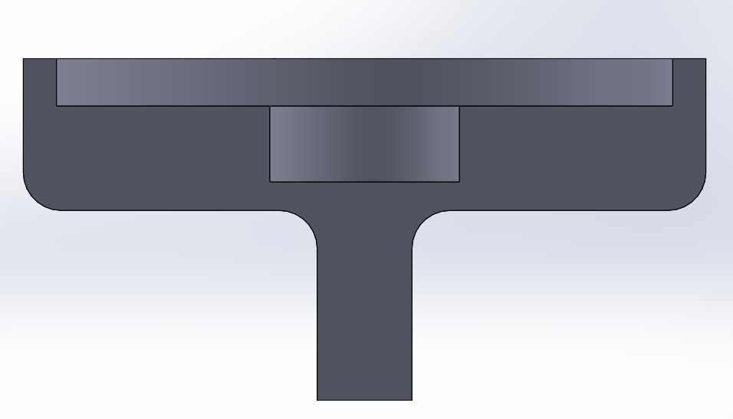
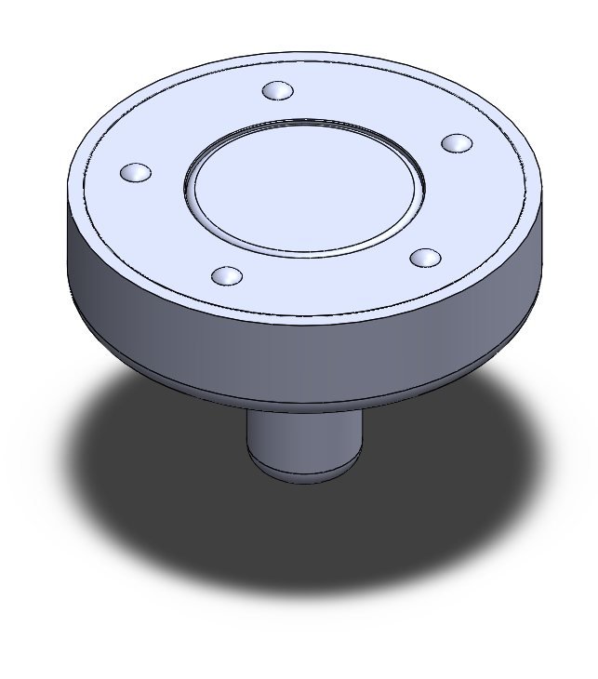
Alpha Design
The Alpha design used two different magnets:
Top magnet - ½ inch diameter neodymium magnet from McMaster - pulls 18lbs
Bottom magnet - 1 inch, ⅛ inch polymagnet
Together they give ~8N of shear strength with ~3N of friction
Requirements: >6N of shear strength
Notes:
Jose

Slide 31
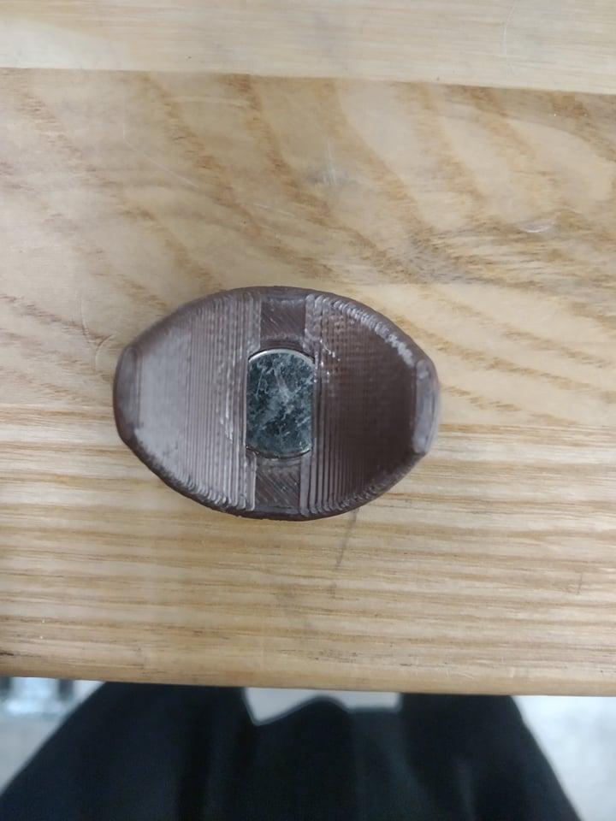
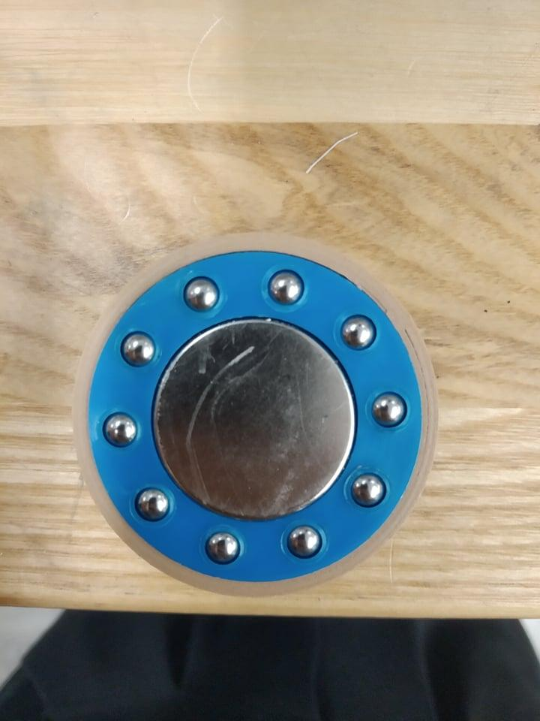
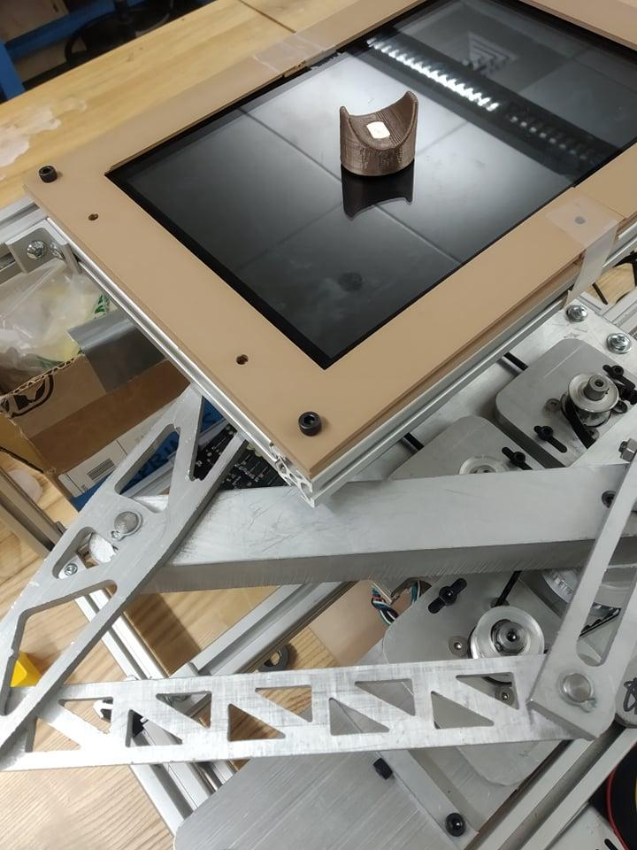
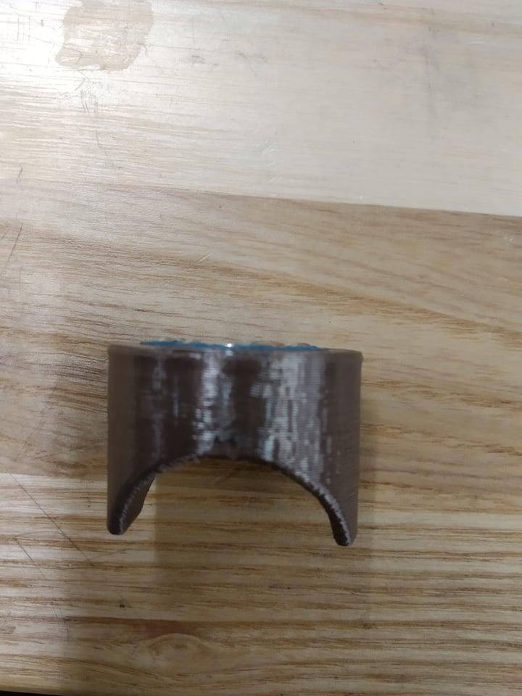
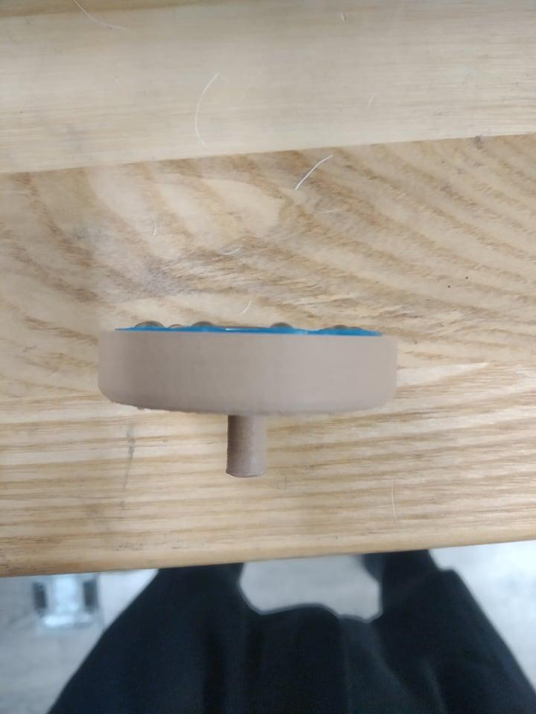
Alpha Design

Slide 32
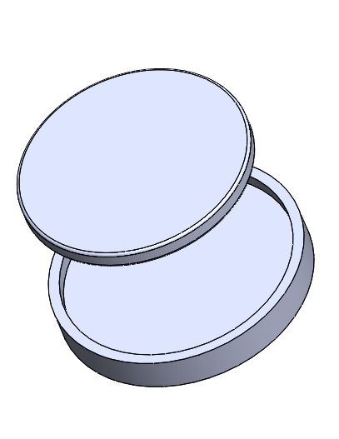
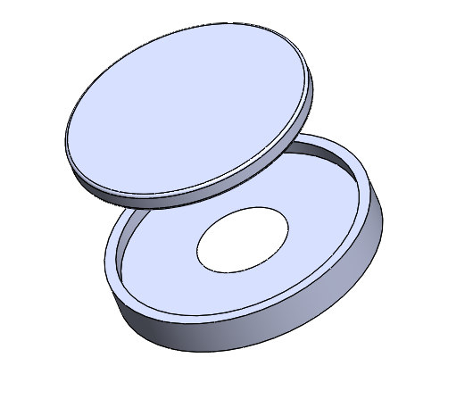
Beta Design: top magnet
For the final top magnet we are using a 0.75” polymagnet with a ring like user interface.
The magnet of the left has no opening
The magnet on the right has an opening to enable grounding through the user - this allows for determining the positioning of the user on the screen

Slide 33
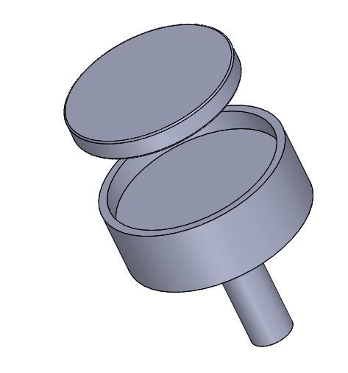
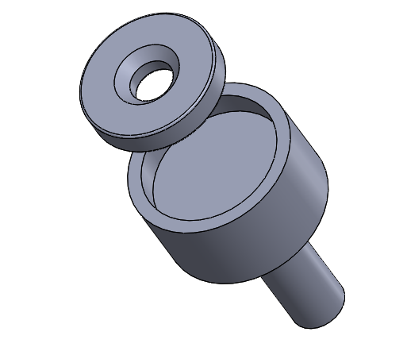
Beta Design: bottom magnet
For the final bottom magnet we are using a 1”x0.125” a 0.625”x0.125” polymagnet with 3D printed holder.
The weaker 0.625” magnet is to be used underneath the user directed top magnet
The stronger 1” magnet is to be used underneath the robot controlled top magnet

Slide 34
Design Overview: Electronics

Slide 35
Wire Diagram
Phase ABC
Phase ABC
Axis0
Axis1
Touchscreen
Motor
Gearbox
Motor
Gearbox
GND
FFC
FFC
Touch
sensor
HDMI
Driver
Power
Odrive
Encoder
Encoder
USB
HDMI
3.3V GND A B X
3.3V GND A B X
Raspberry Pi
TX
RX
Power
RX
TX
Power Supply
GND
STM32
TX
GND
RX
Notes:
Ray

Slide 36
Communication
STM32 and Odrive -> UART(ASCII)
STM32 and Nvidia -> UART(ASCII)
Odrive and encoder -> SPI(Serial Peripheral Interface)
Nvidia and touch sensor -> I2C (Wire with USB)
Share GND to obtain right value
Notes:
Ray

Slide 37

Key Component - Raspberry Pi
Job
Drive the touchscreen
Mouse tracking
Send data to STM32
Notes:
Ray

Slide 38

Key Component - STM32
STM32 and Odrive -> UART(ASCII)
Baud rate: 115200
Request position and velocity(unit in revolution)
Receive data and preprocess(offset elimination and reduction ratio calculation) to get actual angle.
Calculate position in 2D tablet and Jacobian
Determine the force act on end-effect and trans to torque with Jacobian
Send cmd to Odrive
500Hz
STM32 and Nvidia -> UART(ASCII)
Baud rate: 11520
Request touchscreen position
50Hz
Notes:
Ray

Slide 39

Key Component - Odrive
Python lib odrivetool
DC power voltage input range 12-56V
Peak current 120A per motor
UART communication
Position control and input torque
Notes:
Ray

Slide 40
Key Component - Odrive
Odrive calibration config
Odrv0.axis0.motor.config
Odrv0.axis0.controller.config
Odrv0.axis0.encoder.config
Difference between axis0(green) and axis1(pink)
Odrv0.axis0.controller.config.pos_gain = 100
Odrv0.axis1.controller.config.pos_gain = 200
Notes:
Ray

Slide 41


Key Component - Encoder
AMT102-V from CUI Devices
Quadrature resolutions 2048 PPR(Pulses Per Revolution)
Counts Per Revolution 2048*4
Creates linear resolution of 28 μm at end effector
Notes:
Ray

Slide 42

Key Component - Touchscreen
10” x 7” Display (1280*800 pixel)
Single point touchscreen
Run tablet off of Nvidia Jetson Xavier NX
Touch sensor with USB
Notes:
Ray

Slide 43

Key Component - Touchscreen
Using python lib pyautogui
Tracking mouse position
Return position values in pixel
CRITICAL: Touchscreen only supports single touch
Notes:
Ray

Slide 44
Design Overview: Software

Slide 45

Control System: Control Theory – Passive
Notes:
Cam

Slide 46

Control System: Control Theory – Active
Notes:
Lio

Slide 47

Control System: Control Theory – Active
Notes:
Lio

Slide 48
Documentation Map
Review of High-Level Goals
Design Overview
CAD
Key Supporting Analysis
Demonstrations
Notes:
Cam

Slide 49
CAD Files & PDF Of Toleranced Drawings
CAD files and drawings can be found at:
RDS 2022 Student Access Folder/Tablet/CAD
If you have a GrabCAD account they can also be found at:
Link to GrabCAD

Slide 50

Assembly Drawings

Slide 51

Assembly Drawings

Slide 52

Assembly Drawings

Slide 53


Assembly Drawings
PDF Drawings

Slide 54


Assembly Drawings
PDF Drawings

Slide 55

Assembly Drawings
PDF Drawings

Slide 56


Assembly Drawings
PDF Drawings

Slide 57
Documentation Map
Review of High-Level Goals
Design Overview
CAD
Key Supporting Analysis
Demonstrations
Notes:
Cam

Slide 58

Calibration
Turn off motor let user to move freely
Record (u,v) screen (t1, t2) pairs - about 15-30 pairs
Using nonlinear optimization to solve overdetermined equations to get zero points of arm and installation transformation.
We use
R_ppi represent PPI of screen
R_sa represent rotation matrix 2d from arm to screen
t_sa represent translation 2d from arm to screen

Slide 59

Calibration reprojection graph
Our calibration mean error is about 9 pixel (just 1.6mm) which is acceptable.

Slide 60

Motor Selection
BLY172D-24V-2000 from Anaheim Automation
Continuous torque: 0.2N-m
Torque constant: 0.055 N-m/A
Continuous speed: 2000 rpm
Motor inertia: 48.0 g-cm2
Notes:
Ray

Slide 61

Gearbox Selection
GBPS-0401-CS-005 from Anaheim Automation
Gear ratio: 5:1
Backlash: 0.1 degrees
Efficiency: 95%
Notes:
Ray

Slide 62

Gearboxes
Weaker magnets allow for a weaker end effector and lesser torque required. Hence, gearboxes could be removed from the drive train.
Pros
No backlash
Reduced reflected inertia & friction
Re-gain budget
Cons
Less force at end effector (1.7 N)
Necessitates transmission changes

Slide 63

Condition Number Plot
*For right linkage

Slide 64

Resolution Plot
*For right linkage

Slide 65

Backlash Plot
*For right linkage

Slide 66
Force Plot
*For right linkage

Slide 67

Torque Plot
*For right linkage

Slide 68

Reflected Inertia Plot
*For right linkage

Slide 69
Documentation Map
Review of High-Level Goals
Design Overview
CAD
Key Supporting Analysis
Demonstrations
Notes:
Cam

Slide 70

Demo 1: Sensing Functions
Translating the concept of a function into an haptic experience for visual impaired individuals

Slide 71

Demo 1: Sensing Functions

Slide 72

Demo 2: virtual knob
Creating the physical experience of knob on a digital screen

Slide 73

Demo 3: Knob + Shape sensing
Using a virtual knob to create the sensation of a shape

Slide 74
Other Demonstrations
Other demonstrations and videos can found in the google drive under:
RDS 2022 Student Access Folder/Tablet/Media

Slide 75
Link to GIT REPO
https://github.com/sjtuyuxuan/Tablet

Slide 76
Link to BOM
RDS 2022 Student Access Folder/Tablet/Tablet BOM

Slide 77
Link to User Guide
https://github.com/sjtuyuxuan/Tablet/tree/master/UserGuide

Slide 78
User Guide - Firmware
STM-32 Program (already flashed v2.0)
Install STM-32Cube IDE
From GItHub Link download project (v3.0)
Flash it into the Micro-controller
Raspberry Pi Gui
From GItHub Link download (gui.py for v2.0 STM-32 firmware, gui_v3.0.py for v3.0 STM-32 firmware)
Odrive
Firmware is already setup.

Slide 79
User Guide - Software
Raspberry Pi Gui code
Run python3 gui.py or python3 gui_v3.0.py in terminal.
Direct test with finger touch on the screen whether the code is working well.
STM-32
The user button is broken, so only the reset button is on the broad. We will use it for later calibration.
Odrive
Every time we restart the power of Odrive or one motor is out of control because of collision or other reasons, we need to redo the calibration sequence provide by odrive.
Note that the arm will move CCW for about 60-70 degree. PLEASE reserve enough space or the calibration sequence will not run successfully.

Slide 80

User Guide - Demos
Finish testing the Firmware and Software. Follow the guides below:
OPEN the Gui on Raspberry Pi with Demo 1 scenario AND touch the mouse(touch point) to the left up corner (from arm perspective).
Connect the odrive with USB cable to PC and use python interface to do the calibration sequence for two motor. Repeat for TWO arms (4 calibrate sequence)

Slide 81
User Guide - Demos cont
3. Let the left arm bottom magnet outside and right ram bottom magnet embedded.
4. Drag the arm to the calibrate anchor point.
Left arm : Match the center point for the hole on the frame work and the hole used to insert the magnet. (We need more accurate for active arm so take off the magnet will help enhance the accuracy)
Right arm : Match the center point for the hole on the frame work and the center of button magnet.
5. Push the Reset button on STM-32. Wait for 10 second, until the arm move.
6. You will have 10 second to let left arm magnet into the hole
7. Demo is working!

Slide 82
User Guide - Demos cont
8. Using 'a'/'s'/'d' on keyboard to switch the demo
i. ‘a' for Demo 1
Ii. 's' for Demo 2
Iii. 'd' for Demo 3 (only support on v3.0)
Iv. 'esc' to quit the Demo
Note !!! switch from Demo 2 to Demo 1 need ensure the left arm is on the left or top (if on the buttom will lead to crash _ you may need calibrate it again!)

